Slide 1
Do now
Write an operationalized hypothesis
Reminders:
Phones away
Bags on floor
Books out
Pens out
Whiteboard
Reminders
Assessment due: next Wednesday

Slide 2
Do now
Explain what a positive and negative correlation shows.
Draw what they look like on a graph
Give an example of each
Reminders:
Phones away
Bags on floor
Books out
Pens out
Whiteboard
Reminders
Assessment due: next Wednesday

Slide 3
Do now
Come up with 3 synonyms for reliability and validity
Reminders:
Phones away
Bags on floor
Books out
Pens out
Whiteboard
Reminders
Assessment due: next Wednesday

Slide 4
Do now
Define:
Prejudice
Stereotypes
Discrimination
Reminders:
Phones away
Bags on floor
Books out
Pens out
Whiteboard
Reminders
Assessment due: next Wednesday

Slide 5
Do now
Outline 3 causes of prejudice
Reminders:
Phones away
Bags on floor
Books out
Pens out
Whiteboard
Reminders
Assessment due: next Wednesday

Slide 6
Activate prior knowledge
1. Discuss:
What does the term unconscious bias mean?
2. When I say so…
Take the unconscious bias test
3. Research using the link on SEQTA and define 3 biases
https://builtin.com/diversity-inclusion/unconscious-bias-examples
Notes:
Teacher questions:
What are the three divisions of the brain?
What is the oldest part of the brain?

Slide 7


Learning Intention
By the end of the lesson I will be able to:
Outline method for reducing prejudice

Slide 8
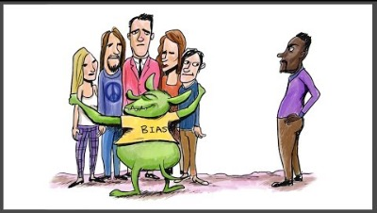
Unconscious bias / Implicit bias
Watch and describe:
What is it?
What groups cam be impacts?

Slide 9
Reducing prejudice
LO: Explain the process of neural transmission (3.3)
Reducing prejudice
Intergroup contact
Self awareness on own biases
Growth mindset
Educations and discussion
representation
Concept Development
Task:
Explore the resources on SEQTA and online and work on your assignment

